Slide 1
June 21, 2018
National Coalition of STD Directors
Notes:
Good afternoon and thank you for joining us for the very first webinar for Et AL: The NCSD Journal Club. My name is Leandra Lacy and I am the Capacity Building Manager for the National Coalition of STD Directors. My hope is that this journal club will not only help to keep you abreast of current STD literature but also that you can use the findings from articles presented and apply them to your own STD programs.

Slide 2
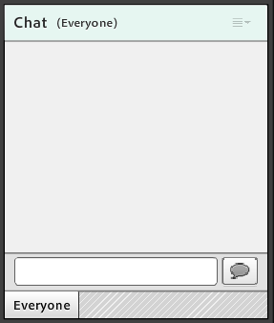
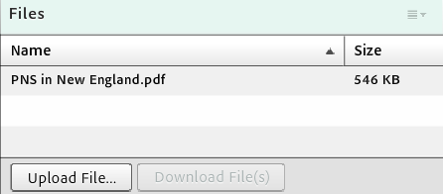
Logistics
Notes:
This is just a reminder that this webinar IS being recorded, and that recording will be made available within one week of this presentation. All lines have been muted. There will be an opportunity at the end to unmute specific lines for questions. If you have questions or need technical help during this call, please utilize the chat function in the bottom right corner of your screen. All questions will be addressed at the end, but we will keep a queue so please send them our way as they come up.
I also want to flag for you that there is a box called “files” on your screen. In this box, you will find the journal article presented, in case you need to download and reference it.

Slide 3
Journal Club Overview
Bi-monthly webinars
Article content will include research on progress in STD diagnostics and new treatments, a focus on specific populations that are disproportionally affected by STDs, etc.
Online content
Blog on NCSD website
Notes:
As I previously mentioned, the purpose of this journal club is to not only help keep you abreast of current STD research and literature but, through engaging discussion, you will learn about the implications of the literature on the STD program in your jurisdiction. Articles chosen will vary and may, for example, include research on progress in STD diagnostics and new treatments, an emphasis on health equity by focusing on populations that are disproportionally affected by STDs, etc.
Each month following a webinar, a blog post will be shared via the NCSD STD Weekly email and on our website, where an author (or authors) of the previous month’s article will answer a few questions regarding the article’s implications for current STD programs and practice and other related areas they feel need to be further research or explored.

Slide 4
Agenda
Introductions
Article background, methods, and results
Discussion
Q&A
Notes:
For our agenda today, we will start with an introduction of our presenters. We will then move into the article background, methods, and results, followed by a time for discussion and engagement with the presenters and the participants. There will also be ample time for questions for the presenters at the end.

Slide 5
Objectives
Describe the major sections of the journal article that is presented (i.e., background, methods, and results).
Identify the journal article’s implications for your state’s STD program.
Notes:
As a result of this webinar, participants will be able to:
1. Describe the major sections of the journal article that is presented (i.e., background, methods, and results).
2. Identify the journal article’s implications for their state’s STD program.
Without further ado, I’ll let our presenters today- Dr. Philip Chan, Tom Bertrand, and Daniel Daltry- take the floor to discuss their article regarding partner notification services in New England!

Slide 6
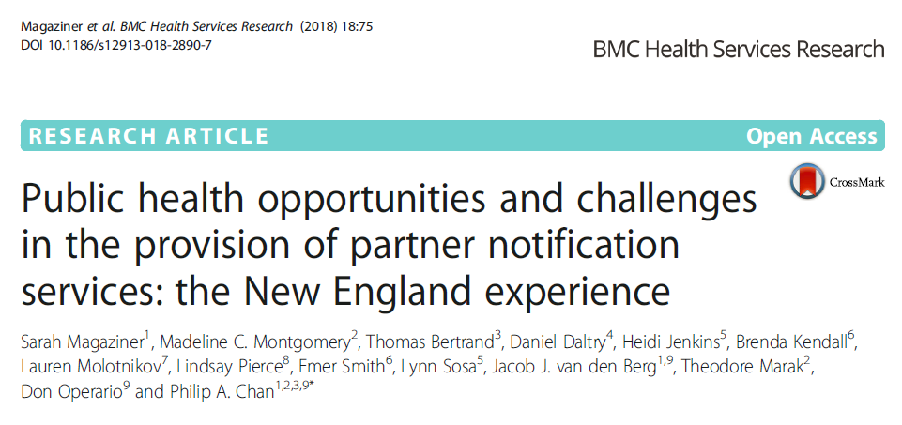

Slide 7
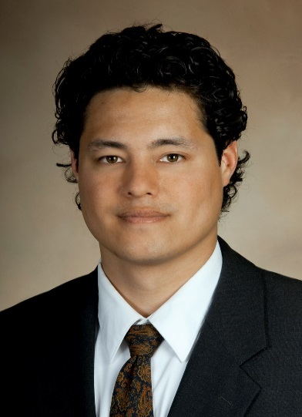
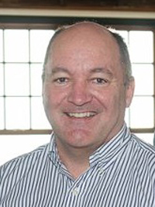
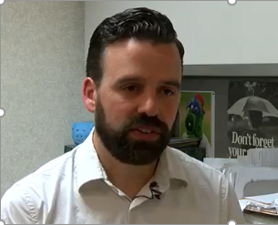
Philip A. Chan, MD
Medical Director, Rhode Island STD Clinic, Providence, Rhode Island
Consultant Medical Director, Center for HIV/AIDS, Viral Hepatitis, STDs, and TB, Rhode Island Department of Health
Thomas E. Bertrand, MPH, MA
Chief, Center for HIV, Hepatitis, STD, and TB Epidemiology, Rhode Island, Rhode Island Department of Health
Daniel J. Daltry, MSW
Program Chief: HIV, STD, and HCV
Vermont Department of Health
The Disease Intervention Specialist for Vermont

Slide 8
INTRODUCTION

Slide 9
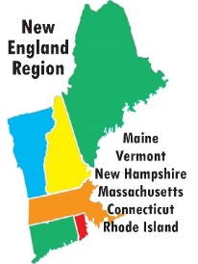
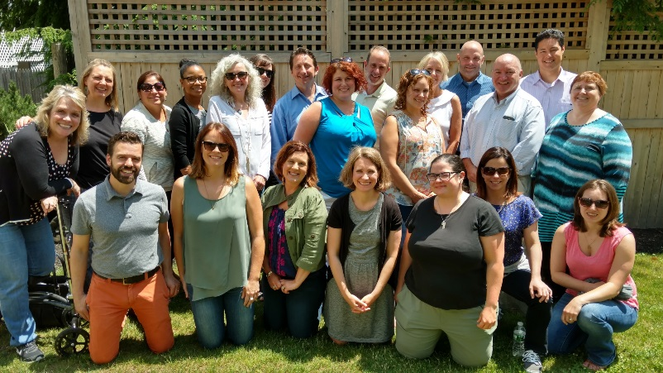
The New England Public Health STD Consortium

Slide 10
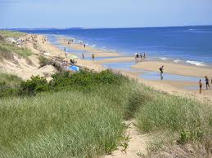
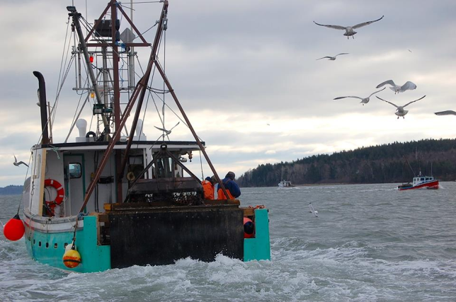
Regional Highlights
Regional Highlights
Notes:
Lakes, beaches, mountains, sports, great food – lobster rolls, quahogs and ben and jerry’s ice cream

Slide 11
Purpose
Create a forum for health department STD directors and local, regional, and national partners to:
Develop regional STD prevention efforts
Share programmatic and epidemiological information
Problem solving/technical assistance
Address growing rates of STDs

Slide 12
Rationale
Decreasing federal funding for state STD programs
Cross-state travel of high-risk individuals
Focal points of sexual activity related to summer tourist attractions, popular bars, and high-risk venues
Comparable population demographics (Maine/NH/VT, CT/RI/MA)
Traditional STD prevention efforts not as effective with emerging populations and the advent of cell-phone technology
Share “best practices” across states
“We can use all the help we can get…..”
Increasing STD rates across the region…..

Slide 13
Chlamydia

Slide 14
Gonorrhea

Slide 15
Primary and Secondary Syphilis

Slide 16
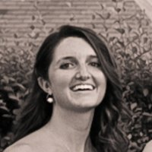
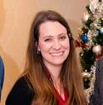
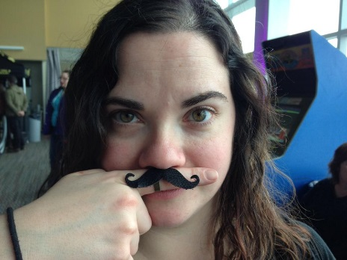
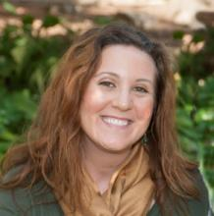
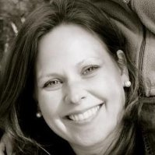
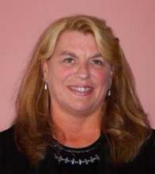
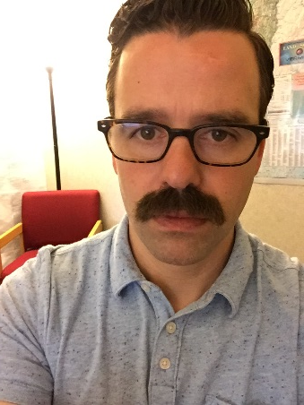
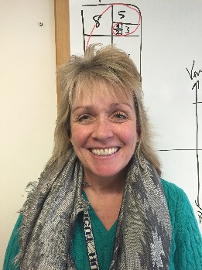
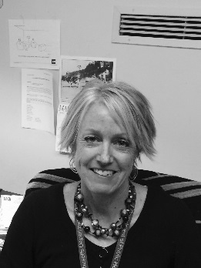
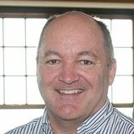
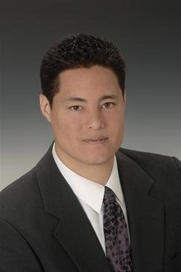
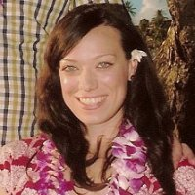
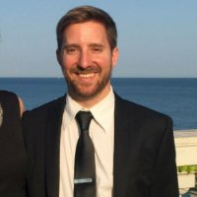
Building Collaboration
State Health Departments
Connecticut
Maine
Massachusetts
New Hampshire
Rhode Island
Vermont
Regional Centers/Programs
Brown University AIDS Program
DHHS Region 1
Sylvie Ratelle Training Center
Yale CIRA
New England AIDS Education and Training Center
Lifespan/Tufts/Brown Center for AIDS Research
NEATC
National Organizations
Centers for Disease Control and Prevention
National Coalition of STD Directors

Slide 17
METHODS
Representatives from health departments in each New England state (Maine, New Hampshire, Vermont, Massachusetts, Connecticut, and Rhode Island)
Online cross-sectional survey
September of 2015
Explored five domains related to how each state conducted PNS

Slide 18
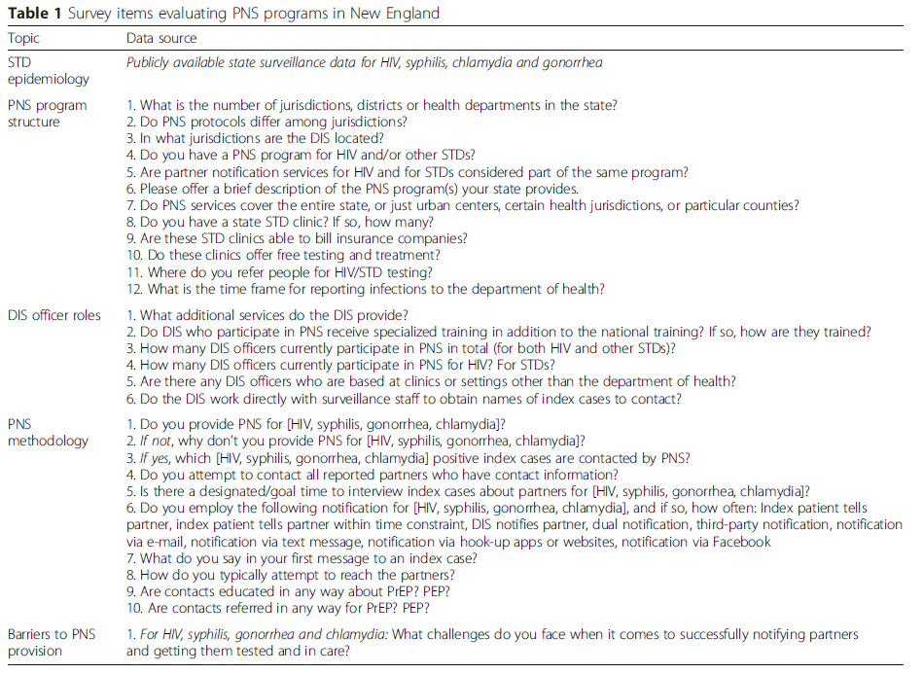

Slide 19
RESULTS
All states had integrated programs for HIV and other STDs.
Uniform PNS protocols across state jurisdictions.
Number of DIS varied from < 1 (NH, VT) to 11 (MA).
Range of responsibilities depending on integration between HIV/STD programs.
Worked closely with surveillance teams to review index cases.
Most based in centrally located offices but travelled to clinical sites for interviews.
Providers required to report cases from 1-4 days after diagnosis.

Slide 20
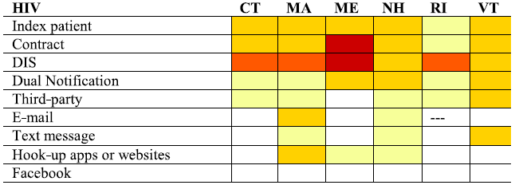
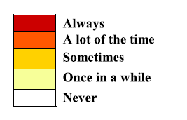
*Phone calls by DIS to identified partners was the most common method of notification. Most states performed phone calls followed by a home visit if no response.

Slide 21
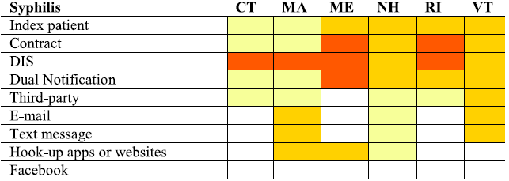

Slide 22
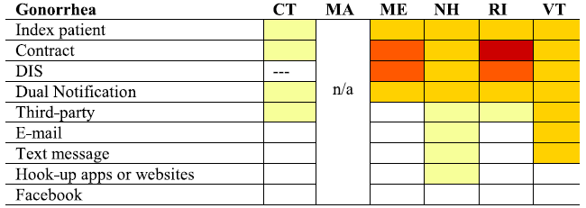
*Massachusetts was unable to offer PNS to gonorrhea cases due to limited resources. Rhode Island focused on gonorrhea cases only in urban centers due to limited resources.

Slide 23
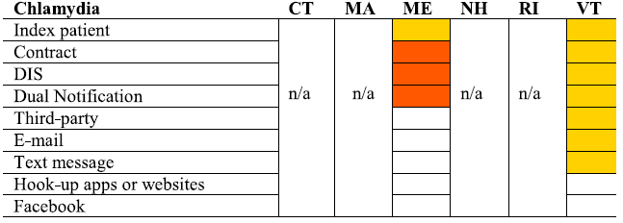
*Partner notification for chlamydia was not routinely provided by states due to limited resources. Vermont did provide partner notification services for pregnant women, and Maine did for individuals co-infected with HIV or gonorrhea and other at-risk populations (e.g. pregnant women, younger men and women). Massachusetts offered services upon provider request.

Slide 24
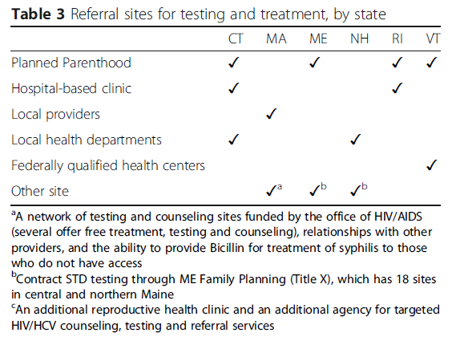
*Rhode Island had one and Connecticut had nine state-funded STD clinics. Other states did not report any state-funded STD clinics.

Slide 25
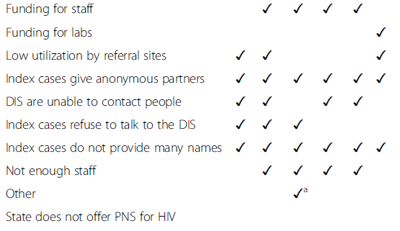
HIV

Slide 26
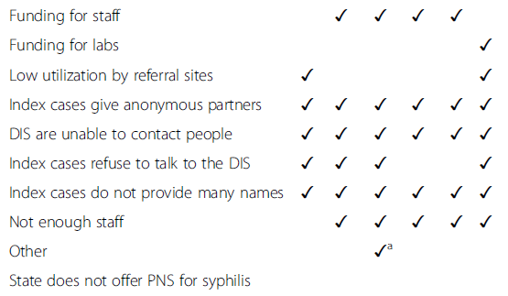
Syphilis

Slide 27
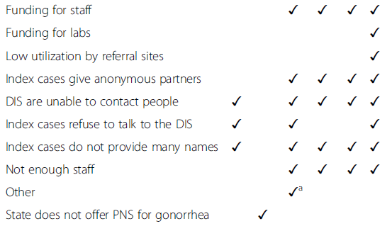
Gonorrhea

Slide 28
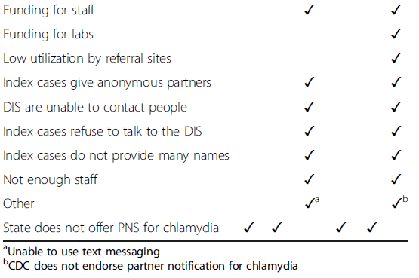
Chlamydia

Slide 29
DISCUSSION
Are you satisfied with your current range of DIS services in terms of:
Which infections you are interviewing?
What modality you are using for interviews?
Has your current range of DIS services changed as morbidities have risen in your area?
If so, what has changed and why?
What concerns do you have about changes to DIS services you have made?
What barriers have you experienced with clients in performing DIS services?
What are some of the solutions you have found for the experienced barriers?
What is your vision of the services DIS will provide in the future?

Slide 30
QUESTIONS?
Dr. Philip A. Chan
PChan@Lifespan.org
Daniel J. Daltry
daniel.daltry@vermont.gov
Thomas E. Bertrand
Thomas.Bertrand@health.ri.gov
Leandra M. Lacy
llacy@ncsddc.org
Notes:
Now we will take questions from any one who is participating. Feel free to type your question into the chat box or unmute your line to ask it on the phone line.
With that, I’d like to say thanks to all of you who attended the very first webinar for Et. Al: The NCSD Journal Club. I have included the presenter’s contact info, in addition to mine on this slide. Feel free to reach out for additional questions. In the chat box, I have also included the link for the very brief webinar evaluation. Please complete it so that it can inform future journal club webinars. Have a wonderful day, and be on the look out for the blog related to this article in July and then the next journal club meeting in late August.

