Slide 1
August 20, 2018
Notes:
Good afternoon and thank you for joining us for the second installment of Et AL: The NCSD Journal Club. My name is Leandra Lacy and I am the Capacity Building Manager for the National Coalition of STD Directors. My hope is that this journal club will not only help to keep you abreast of current STD literature but also that you can use the findings from articles presented and apply them to your own STD programs.

Slide 2
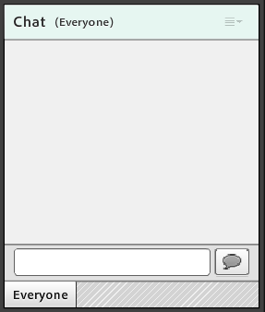
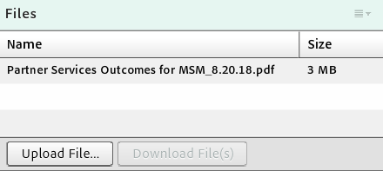
Logistics
Notes:
This is just a reminder that this webinar IS being recorded, and that recording will be made available within one week of this presentation. All lines have been muted. There will be an opportunity at the end to unmute specific lines for questions. If you have questions or need technical help during this call, please utilize the chat function in the bottom right corner of your screen. All questions will be addressed at the end, but we will keep a queue so please send them our way as they come up.
I also want to flag for you that there is a box called “files” on your screen. In this box, you will find the journal article presented, in case you need to download and reference it.

Slide 3
Journal Club Overview
Bi-monthly webinars
Article content will include research on progress in STD diagnostics and new treatments, a focus on specific populations that are disproportionally affected by STDs, etc.
Online content
Blog on NCSD website
Notes:
As I previously mentioned, the purpose of this journal club is to not only help keep you abreast of current STD research and literature but, through engaging discussion, you will learn about the implications of the literature on the STD program in your jurisdiction. Articles chosen will vary, depending on emerging issues in the field.
Each month following a webinar, a blog post will be shared via the NCSD STD Weekly email and on our website, where an author (or authors) of the previous month’s article will answer a few questions regarding the article’s implications for current STD programs and practice and other related areas they feel need to be further research or explored.

Slide 4
Agenda
Introduction of presenters
Article background, methods, and results
Discussion
Q&A
Notes:
For our agenda today, we will start with an introduction of our presenters. We will then move into the article background, methods, and results, followed by a time for discussion and engagement with the presenters and the participants. There will also be ample time for questions for the presenters at the end.

Slide 5
Objectives
Describe the major sections of the journal article that is presented (i.e., background, methods, and results).
Identify the journal article’s implications for your state’s STD program.
Notes:
As a result of this webinar, you will be able to:
1. Describe the major sections of the journal article that is presented (i.e., background, methods, and results).
2. Identify the journal article’s implications for your state’s STD program.

Slide 6
Introduction
Sydney Minnerly, Partner Services Coordinator
Karen Surita, Data to Care Coordinator
Notes:
Without further ado, I’ll let our presenters today- Sydney Minnerly and Karen Surita- take the floor. Sydney is the Partner Services Coordinator and Karen is the Data to Care Coordinator at the Texas Department of State Health Services.

Slide 7
Difference in Partner Services Outcomes for Men Who Have Sex With Men Diagnosed With Primary and Secondary Syphilis by HIV Serostatus
Emily Rowlinson, MPH, Samuel Goings, MPH, Sydney Minnerly, MA, Karen Surita, BS and Sargis Pogosjans, MPH
Sexually Transmitted Diseases. 45(3):152-157, March 2018.

Slide 8
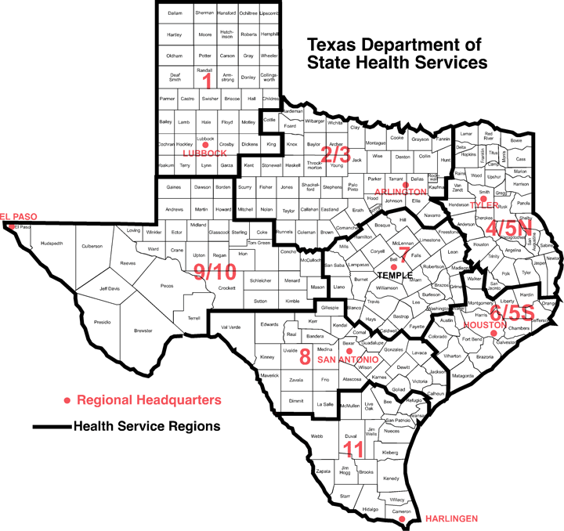
18 Local and Regional Health Departments
~100 DIS workforce
Number of interviews:
Early Syphilis
HIV
Co-Infections

Slide 9
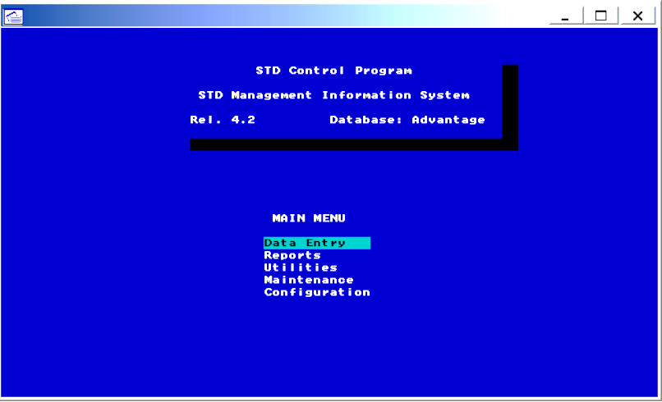
Why analyze the data?
STD*MIS (as old as it is) is a data-rich system!
Need to determine PS outcomes and assess program efficiencies
Provide opportunities to recommend changes

Slide 10
WE CAN’T MEET OUR OBJECTIVES!
OUR PARTNER INDICES ARE DROPPING!
WHAT CAN WE DO?!?
Notes:
WE CAN’T MEET OUR OBJECTIVES!
OUR PARTNER INDICIES ARE DROPPING!
WHAT CAN WE DO?!?

Slide 11
We had so many questions:
What was driving the sustained decrease in partner indices?
What caused an increase in cases resulting in No Partner Initiated (NPI)?
How does HIV status impact program outcomes?
Was there partners services fatigue?
Notes:
We noticed there was a sustained decrease in partner indices across the state, in all jurisdictions
Attributed this to partner selection sites such as internet and hook up applications
But anonymous partner selection venues have always been a part of PS interventions?
Sites were also stating that HIV status influenced “cooperation” with the DIS
How does previous exposures to Partner Services influence interview outcomes?

Slide 12
Notes:
Analyzed data from STD*MIS
January 1, 2013- December 31, 2016
Males, 13 years or older with a DX of primary, secondary, ES 700 reported and initiated for PS, interview was considered complete if they agreed to and interview. They also had a HIV DX at least 30 days prior to their syphilis DX for those who we considered HIV positive.
The criteria to be included in MSM was: male and ( male sexual partners during infection period, or self identification of gay or bisexual or, and reported risk in eHARS or STD*MIS)
Age at syphilis DX
Race
Stage of Syphilis DX
Geospatial applications-
Number of times a person was involved in Partner Services
Prior No partners initiated

Slide 13
Outcomes
66% of cases not interviewed were males who were HIV-positive
80% of MSM who were HIV-positive were previously initiated for interview for HIV or previous STI (in Texas)
48% were named as a sex partner
46% had at least one NPI interview
Notes:
Refused, Unable to Locate and Non Specified
HIV Positive males were less likely to be interviewed but were no more likely to refused than their HIV negative counterparts
Second bullet: Almost half were named as a sex partner

Slide 14
Proportion of ES Interviews with NPI Interviews by Year, 2013- 2016
Notes:
There was a generalized increase in NPI interviews for MSM from 2013-2016, this trend was significant for both HIV Positive and Negative MSM.
More than 40% of the interviews for HIV positive MSM were NPI compared to lower percentage 23% in HIV negative MSM.
HIV negative MSM named more partners compared to HIV positive MSM 1.9 vs 1.2
All Partner services outcomes were significantly higher for MSM who were HIV+ than those who were negative

Slide 15
Discussion
Previous NPI was a stronger predictor than HIV serostatus for future NPI
People who were previously initiated as a partner were more likely to participate in PS
Geospatial users had a higher partner indices
Notes:
HIV Positive MSM
Partner Services elicited fewer partners, named partners were less likely to receive for treatment were indicated, more likely to result in NPI
How does the attitude of the DIS contribute to NPI?
Cultural competency trainings focusing on impacted communities
Decrease workload of DIS- an over burden staff may be willing to take more shortcuts or rush an interview that they expect to not be productive
Advocating
Geospatial users were more likely to name partners, this data disproves the belief from programs that individuals who name applications are more likely to have NPIs

Slide 16
Future Activities
Advocate for alternative applications for interview techniques
Develop methods for documentation of Marginals
Documentation of partner selection venues
Notes:
telephone, facetime, self referral and internet based
Implement methods for DIS to electronically document Marginals
What venues are truly being used? And are there some that are influencing PS more than others?
The ability to initiate marginal can provide insight on the DIS skill set to probe and differentiate between NPI and marginal initiated

Slide 17
We still do not know the full story…
What is truly driving the decrease in partner indices?

Slide 18
Other questions for discussion
Have you noticed a similar trend of decreasing partner indices for MSM in your jurisdiction, based on HIV serostatus?
If so, what strategies have been employed in order to address it?
How have DIS changed their interview techniques?
How are you assessing and documenting partner selection venues?
What other challenges have you experienced in engaging with clients who are co-infected?
If partner indices are high, why do you think that is?

Slide 19
What questions do you have?
Sydney Minnerly
Sydney.Minnerly@dshs.texas.gov
Karen Surita
Karen.Surita@dshs.texas.gov
Leandra Lacy
llacy@ncsddc.org
Notes:
Now we will take questions from any one who is participating. Feel free to type your question into the chat box or unmute your line to ask it on the phone line.
With that, I’d like to say thanks to all of you who attended the second installment of Et. Al: The NCSD Journal Club. I have included the presenter’s contact info, in addition to mine on this slide. Feel free to reach out for additional questions. In the chat box, I have also included the link for the very brief webinar evaluation. Please complete it so that it can inform future journal club webinars. Today’s recording and slides will be sent to all those who registered within the next week. Have a wonderful day, and be on the look out for the blog related to this article in September and then the next journal club meeting in October.

