Slide 1
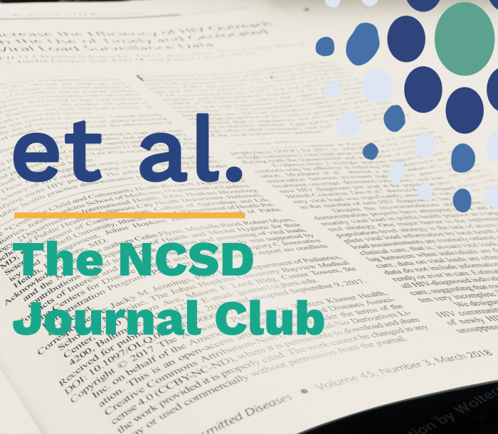
October 24, 2018
Notes:
Good afternoon and thank you for joining us for the third installment of Et AL: The NCSD Journal Club. My name is Leandra Lacy and I am the Capacity Building Manager for the National Coalition of STD Directors. My hope is that this journal club will not only help to keep you abreast of current STD literature but also that you can use the findings from articles presented and apply them to your own STD programs.

Slide 2
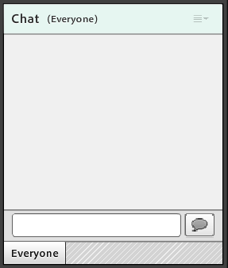
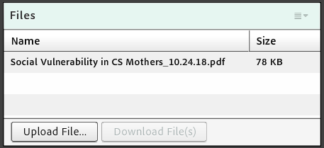
Logistics
Notes:
This is just a reminder that this webinar IS being recorded, and that recording will be made available within one week of this presentation. All lines have been muted. There will be an opportunity at the end to unmute specific lines for questions. If you have questions or need technical help during this call, please utilize the chat function in the bottom right corner of your screen. You can private message my colleague Neil Rana, who is listed as a host, or myself. I am listed as Sara Stahlberg. All questions will be addressed at the end, but we will keep a queue so please send them our way as they come up.
I also want to flag for you that there is a box called “files” on your screen. In this box, you will find the journal article presented, in case you need to download and reference it.

Slide 3
Agenda
Introduction of presenters
Article background, methods, and results
Discussion
Q&A
Notes:
For our agenda today, we will start with an introduction of our presenters. We will then move into the article background, methods, and results, followed by a time for discussion and engagement with the presenters and the participants. There will also be ample time for questions at the end.

Slide 4
Objectives
Describe the major sections of the journal article that is presented (i.e., background, methods, and results).
Identify the journal article’s implications for your state’s STD program.
Notes:
As a result of this webinar, you will be able to:
1. Describe the major sections of the journal article that is presented (i.e., background, methods, and results).
2. Identify the journal article’s implications for your state’s STD program.

Slide 5
Introduction
Social Vulnerability in Congenital Syphilis Case Mothers:
Qualitative Assessment of Cases in Indiana, 2014 to 2016.
Dawne DiOrio
Public Health Advisor
Amara Ross
STD Epidemiologist
Notes:
Today, our presenters will be Amara Ross, an STD Epidemiologist, and Dawne DiOrio, a Public Health Advisor who is also a founding member of NCSD and former STD Program Director for the state of Maine. Both Amara and Dawne now work at the Indiana State Department of Health. They will be highlighting an article they are authors on, entitled “Social Vulnerability in Congenital Syphilis Mothers: Qualitive Assessment of Cases in Indiana, 2014-2016,” which was published in the July issue of the STD Journal.
Dawne- I will let you begin!

Slide 6
Introduction
Congenital syphilis (CS) is the transmission of a syphilis infection from an untreated pregnant woman to the fetus
Preventable with early detection and treatment
Occurrence signals a failure of both syphilis detection mechanisms and prenatal care systems
Following a five year decrease (2008-2012), cases of congenital syphilis have risen each year since 2013 nationwide

Slide 7
Congenital Syphilis Trends – US & IN
Congenital Syphilis – Reported Cases by Year of Birth and Rates of Reported Cases of Primary and Secondary Syphilis Among Women Aged 15-44 Years, United States, 2008-2017 (Figure 49)¹
The recent increases in congenital syphilis cases have been associated with increase in infectious syphilis (primary and secondary) among women¹
1. Centers for Disease Control and Prevention. Sexually Transmitted Disease Surveillance 2017. Atlanta: U.S. Department of Health and Human Services; 2018.
Notes:
In the United States, the congenital syphilis case rate increased 86.9% between 2012 and 2016
In the United States, the congenital syphilis case rate increased 153.3% between 2013 and 2017
Number of cases increased 153% between 2013 and 2017.
Between 2014 and 2016, 65.7% increase in female syphilis cases
Rates continued to rise in 2017 by 43.8% to 23.3 cases per 100,000 live births

Slide 8
Congenital Syphilis Trends – US & IN
8
Notes:
Primary and secondary syphilis cases among Indiana women increased 227.3% between 2014-2016 (11 cases to 36 cases)
In Indiana, no cases of congenital syphilis were reported between 2008 and 2013
23 cases in the following three years

Slide 9
What is known
Socioeconomic and geographic differences
Late initiation or lack of prenatal care (PNC)
“Missed opportunities” by health care provider for screening or treatment (i.e., incorrect medical management)
Nearly all US studies to date examine reasons for CS on large scale data (eg all birth certificates; multi-year hospital records)

Slide 10
What is known
Lack of prenatal care
Late initiation of prenatal care
Lack of health insurance
Late enrollment in Medicaid
No transportation
No child care
Food insecurity
Insecure housing
Violence
Poverty
Low educational levels
Social isolation
Lack of control in one’s life
Unplanned/unwanted pregnancy
Psychological stresses
Other risky lifestyle choices
Incarceration
Drug use
Mental health
Substance abuse
Cost of copays

Slide 11
Research Methods
Case Reviews
DIS interview notes from case mother syphilis investigations
Maternal records with information regarding pregnancy history and prenatal care
Objectives
Did case adhere to established CDC and ISDH screening and treatment guidelines?
Coding for common themes
Coded Factors
Demographics, syphilis diagnosis, prenatal care (PNC), HIV status, housing stability, domestic violence, incarceration, drug use, health insurance, syphilis diagnosis of male syphilis partner
Notes:
Explain that maternal records are the maternal portion of the congenital syphilis case report form

Slide 12
Results

Slide 13
The 23 CS Cases: Demographic and Disease-related information
Maternal Syphilis Cases | # Cases
Syphilis less than 1 year’s duration | 14
Syphilis greater than 1 year duration | 11
Male sex partner also had syphilis | 7
Negative syphilis test in early pregnancy | 7
Mother diagnosed with syphilis twice during pregnancy | 2
HIV-positive mother | 1
Average age: 26.1 years
Most had health insurance (91%)
Note: Duration rows total 25 because two cases had syphilis twice
13
Notes:
None reported Hispanic ethnicity
91.3% had health insurance

Slide 14
Prenatal Care Among Case Mothers
Prenatal Care (PNC) Among Case Mothers | # Cases
Mothers with no PNC | 8
Mothers with PNC | 15
Healthcare provider followed screening and treatment recommendations | 15
First visit in 1st Trimester | 12
PNC “inadequate” | 10
3 stillbirths
1 had no PNC
2 had inadequate PNC
Note: Number of visits ranged 1 – 33, Median= 4 visits
14
Notes:
3 stillbirths: 1 born alive and then died

Slide 15
The research question
Since we learned that no CS cases in our group could be attributed to health care provider behavior, what factors present in the mother’s life seemed to be associated?
Important to note this study does not allow us to attribute causality

Slide 16
Themes identified from document review
Social vulnerability
Lack of engagement in health care
Male sex partner risk
Important to note that most women experienced all three at once

Slide 17
Social Vulnerability
Incarceration of mother or male partner (current or within last 2 years)
Drug Use and domestic violence (underreported)
Chaotic living conditions including homeless
Medicaid proxy for low income
No job or “bad job”

Slide 18
Social Vulnerability (cont.)
39% were homeless or had an unstable housing situation
35% had history of incarceration in the last two years (case mother only, male sex partner only, both case mother and male sex partner)
9% admitted drug use within the last year

Slide 19
Lack of engagement in health care
Difficulty following through when tests were ordered (at off-site lab from PNC provider office)
Difficulty obtaining treatment when syphilis diagnosed after many attempts by doctor and the STD DIS
Reason not specified except for:
One mother stated she was unable to take time off from her minimum-wage, fast food job for lab work and prenatal appointments because she would not be paid (example of “bad job” influence)

Slide 20
Male partner risk
Nearly one-third of the mothers’ ONLY risk for contracting syphilis was her primary (steady/only named) sex partner
Seven of these primary male partners were newly identified as syphilis cases as a result of the woman’s diagnosis
Two of the steady male partners refused to be tested or receive prophylactic treatment despite health care provider and DIS intervention
Two case mothers were reinfected with syphilis during the same pregnancy by their steady male partner, despite intensive DIS intervention

Slide 21
Congenital Syphilis is 100% preventable
But many factors have to be in place to ensure the case is averted, such as:
Woman tested for syphilis (if pregnant)
Woman tested for pregnancy (if she has syphilis)
Adequate treatment if positive test – 1 shot?, 3 shots?
Treatment must be given 30 days or more before birth
For any of these to occur, women must have knowledge of syphilis and pregnancy, should have an accurate self-perception of risk, should have personal motivation for health care, and capacity to carry out intentions
At each of these steps, social or structural challenges and barriers may present themselves

Slide 22
CS is preventable, but…..
The woman needs to have structural supports in place that enable her to get care such as: health insurance or a payment source, access to a medical provider and the ability to get there (transportation, child care, time off work)
Also requires the medical provider to do their part for timely and adequate testing, correct treatment based on syphilis stage
And if late diagnosis, treatment may not be able to be given 30 days before delivery (preterm birth common in syphilis patients)

Slide 24
Two recent studies on CS
Kidd, et al (2018) examined 2016 U.S. syphilis case reports and CS case reports for “CS Prevention Cascade”
75% of CS cases were averted through action by health care provider, pregnant woman, and public health
Largest gaps in prevention services among CS moms: 1) at entry into PNC; and 2) between early testing and timely treatment

Slide 25
New studies (cont.)
Sanderson Slutsker, et al examined NYC syphilis case reports and CS case reports 2010-2016
88% of CS cases averted through health care provider, pregnant woman, and public health action
31% of CS case moms did not get timely PNC

Slide 26
New studies (cont.)
Of 69% with timely PNC
9% did not receive syphilis test until <45 d before delivery
47% became infected after neg. syphilis test
Based on these recent studies, MOST syphilis cases in pregnant women do NOT result in a case of CS

Slide 27
What is known beyond CS
Worldwide (OECD countries) and within the U.S. (state comparison), health issues are greatly impacted by the amount of “social spending”
20% increase in median social-to-health spending ratio = 85K fewer obese adults, eg
Health spending in U.S. great variation by state (Indiana 49/50 per capita for PH funding)

Slide 28
Similar findings
Sanderson Slutsker findings similar to ours
Among CS case moms with PNC, identified substance abuse, mental health disorders, recent arrival to U.S., and lack of health insurance (24% of CS case moms)
One mom neg test 2nd trimester, ED visit 3rd trimester with syphilis symptoms (no intervention), delivery test positive

Slide 29
Conclusion
“Preventing congenital syphilis in the U.S. may require a focus on both ameliorating the social vulnerabilities affecting pregnant women with syphilis, and traditional medical management.”

Slide 30
How can findings be applied? STD Program
Conduct similar CS case review to identify factors leading to cases in your state
Have DIS collect supplemental information on pregnant syphilis interviews to aid understanding
Identify males at risk for syphilis who have pregnant partners so they may be tested and treated before transmitting infection to the woman
Explore syphilis testing in hospital emergency departments and urgent care centers for pregnant women not in PNC

Slide 31
How can findings be applied? LHD or community
Strengthening links in the social and health safety net for vulnerable women so we may identify those who have discontinued prenatal care; fail to obtain syphilis testing or treatment; identify those who may benefit from supportive case management
Identify which tangible (structural) services may be lacking for pregnant women in a community such as transportation, child care, availability of PNC providers especially those accepting Medicaid

Slide 32
How can findings be applied? Health care providers
Identify males at risk for syphilis who have pregnant partners so they may be tested and treated before transmitting infection to the woman
Consider using syphilis point-of-care tests to reduce likelihood of a woman not getting testing from an off-site laboratory due to cost, transportation, or scheduling

Slide 33
Additional references
Variation In Health Outcomes: The Role Of Spending On Social Services, Public Health, And Health Care, 2000–09, Elizabeth Bradley et al, Health Affairs, Vol 35, No. 5, https://doi.org/10.1377/hlthaff.2015.0814
https://www.tfah.org/report-details/a-funding-crisis-for-public-health-and-safety-state-by-state-public-health-funding-and-key-health-facts-2017/

Slide 34
Slutsker JS, Hennessy RR, Schillinger JA. Factors Contributing to Congenital Syphilis Cases — New York City, 2010–2016. MMWR Morb Mortal Wkly Rep 2018;67:1088–1093. DOI: http://dx.doi.org/10.15585/mmwr.mm6739a3.
Kidd S, Bowen V, Torrone, E, Bolan, G, Use of National Syphilis Surveillance Data to Develop a Congenital Syphilis Prevention Cascade and Estimate the Number of Potential Congenital Syphilis Cases Averted. Sex Trans Dis 2018;45 (9S) S23 DOI:10.1097/OLQ.0000000000000838

Slide 35
Group Discussion
What strategies has your health department or organization employed to address congenital syphilis in your area?
Any similar strategies as those listed previously?
How has your health department or organization partnered with local agencies to address congenital syphilis and/or social vulnerability of mothers?
What services already exist?
What barriers have you faced with building partnerships?
How have DIS in your area played a role in addressing these issues?

Slide 36
Additional questions?
Dawne DiOrio
DDiorio@isdh.IN.gov
Amara Ross
ARoss2@isdh.IN.gov
Leandra Lacy
llacy@ncsddc.org
Notes:
Now we will take additional questions from any one who is participating. Feel free to type your question into the chat box or unmute your line to ask it on the phone line.
With that, I’d like to say thanks to all of you who attended the third installment of Et. Al: The NCSD Journal Club. I have included the presenter’s contact info, in addition to mine on this slide. Feel free to reach out for additional questions. In the chat box, there is a link for the very brief webinar evaluation that you will also be redirected to once I close the webinar. Please complete it so that it can inform future journal club webinars. Today’s recording and slides will be sent to all those who registered within the next week. Have a wonderful day, and be on the look out for the blog related to this article in November and then the next journal club meeting in December.

