Slide 1
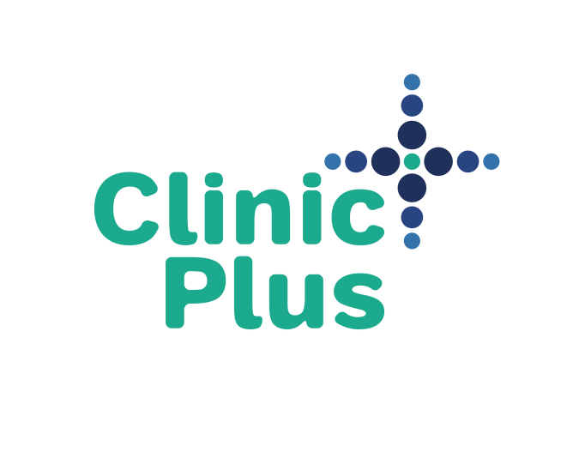
FIGHTING THE SYPHILIS AND HIV EPIDEMICS: VOICES FROM THE FIELD
National Coalition of STD Directors

Slide 2
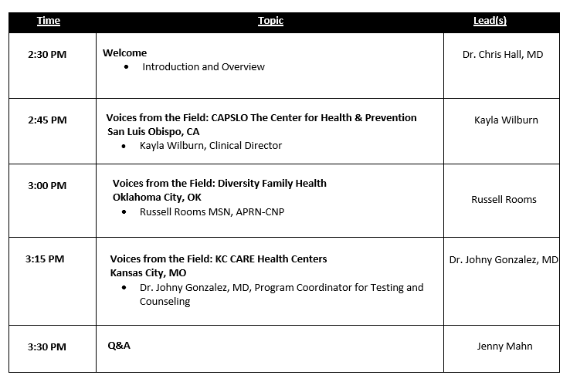
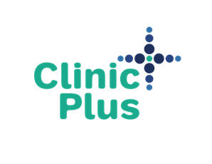
Agenda

Slide 3
HIV-Syphilis: Why the dual test?
Syphilis and HIV: A Dangerous Duo
Facts
Syphilis facilitates HIV acquisition (estimated increase 2- to 4-fold) and transmission (estimated 2- to 9-fold)
Biology
The genital sores (chancres) caused by syphilis make it easier to transmit and acquire HIV infection sexually.
Infection with Treponema pallidum has been shown to decrease CD4 counts in HIV-infected patients and increase HIV viral load.
Syphilis can enhance HIV transmission by increasing viral shedding.
https://www.cdc.gov/std/hiv/default.htm & Buchacz et al. AIDS. 2004 Oct 21; 18(15): 2075–2079

Slide 4
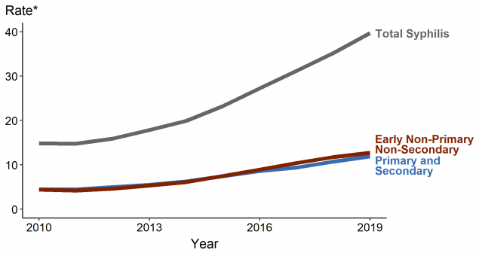
HIV & Syphilis in the United States, 2010-2019
In 2019, approximately 15% of persons living with HIV were unaware of their infection.
In 2017, it was estimated that persons unaware of their HIV status were responsible for 40% of transmission.
In 2016, an estimated 38.5% of men infected with syphilis* were coinfected with HIV, with nearly half of those cases disproportionately affecting MSM.
Syphilis has increased 30.0% during 2018–2019 and 178.6% during 2015–2019
Notes:
https://www.cdc.gov/std/stats18/STDSurveillance2018-full-report.pdf
https://www.hiv.gov/blog/too-many-people-living-hiv-us-don-t-know-it#:~:text=But%20not%20all%20of%20them,they%20are%20living%20with%20HIV.
https://www.cdc.gov/hiv/testing/index.html#:~:text=Background,know%20they%20have%20the%20virus.
Reported Primary and Secondary Syphilis Cases in the United States: Implications for HIV Infection. Sex Transm Dis. 2018 Sep;45(9S Suppl 1):S42-S47.
https://www.cdc.gov/std/statistics/default.htm

Slide 5
Congenital Syphilis – a mounting crisis
The national rate of 48.5 cases per 100,000 live births in 2019 represents a 291.1% increase from 2015-2019.
Although nearly 70% of infants with congenital syphilis are born to mothers who received prenatal care, detection and treatment of maternal syphilis often occurs too late to treat the fetus and prevent congenital syphilis.
Recent data suggest that while screening rates for syphilis infection are generally high, the proportion of women screened earlier in pregnancy remains low (e.g., 20% of women are screened only at the time of delivery).
Untreated syphilis in pregnant women results in infant death in up to 40 percent of cases.
Notes:
https://www.cdc.gov/mmwr/preview/mmwrhtml/mm6444a3.htm
https://uspreventiveservicestaskforce.org/uspstf/recommendation/syphilis-infection-in-pregnancy-screening https://www.ncsddc.org/wp-content/uploads/2017/07/ncs_366_third_trimester_screening_brochure_page_by_page_mechanical_12-28-16.pdf

Slide 6
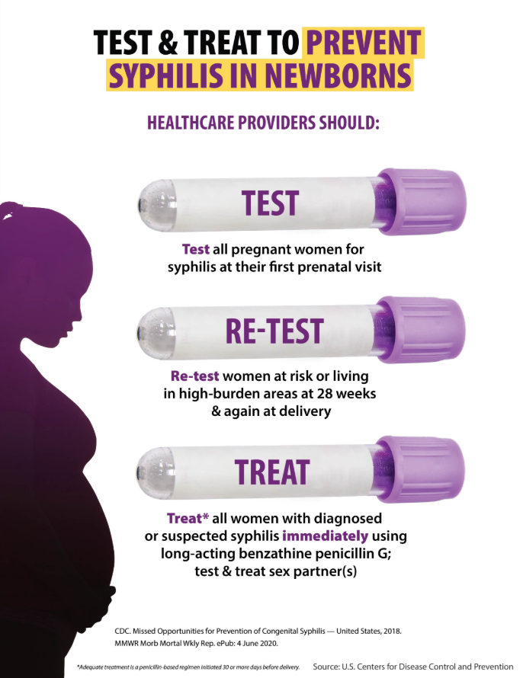
CDC’s State of the Union
First, we must address the rising rate of syphilis among women.
The second part of the equation is straightforward: Protect moms = Protect babies.
Uphold basic STD prevention and control to halt the rising increases of other STDs.
https://www.cdc.gov/std/dstdp/2018-SR-DCL_FINAL.pdf?deliveryName=DM29833
Notes:
Verbally talk about HIV

Slide 7
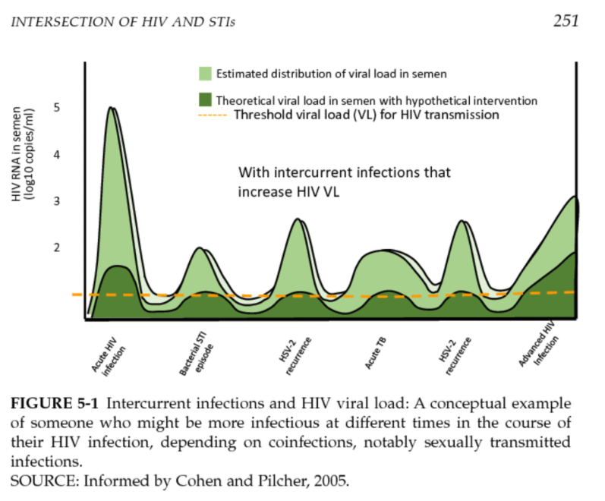
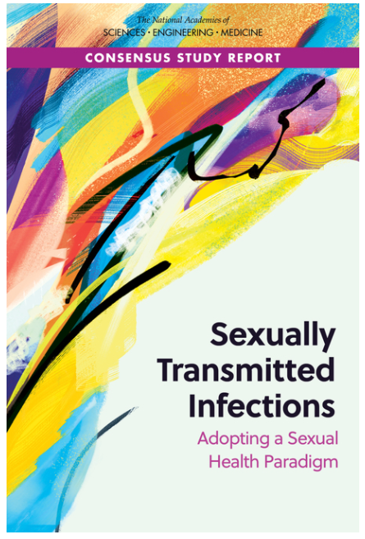
National Academy of Sciences (NASEM) Report, 2021
Adopting a Sexual Health Paradigm
National Academies of Sciences, Engineering, and Medicine. 2021. Sexually Transmitted Infections: Adopting a Sexual Health Paradigm. Washington, DC: The National Academies Press. https://doi.org/10.17226/25955.

Slide 8
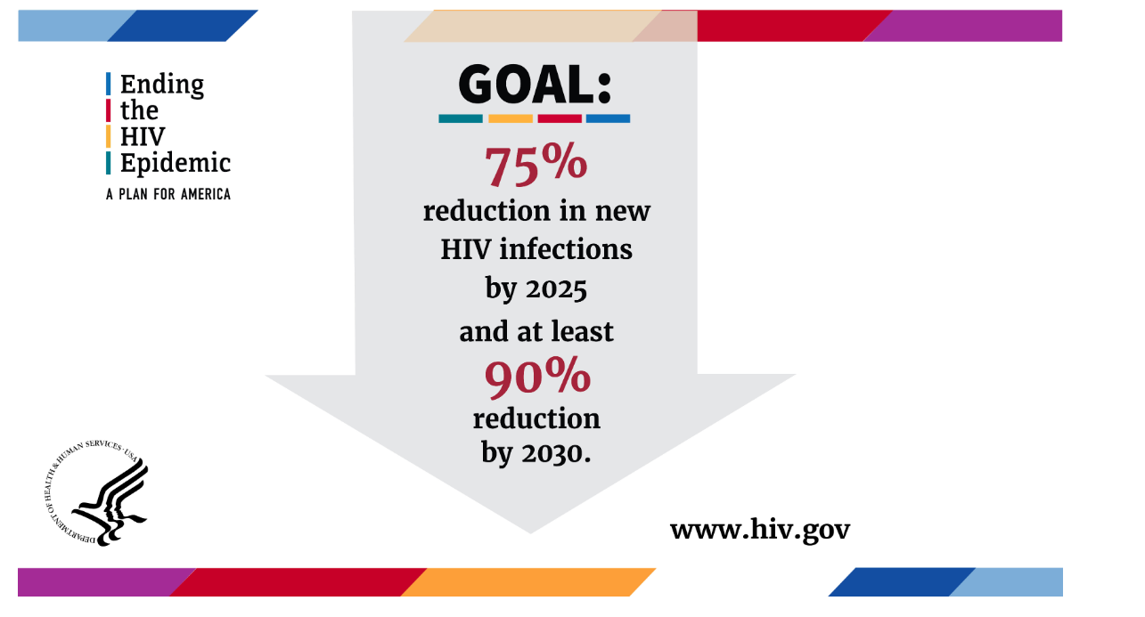
Ending the HIV Epidemic: A Plan for America (EHE)
https://www.hiv.gov/federal-response/ending-the-hiv-epidemic/overview
Notes:
EHE is a bold plan announced in 2019 that aims to end the HIV epidemic in the United States by 2030. Agencies across the U.S. Department of Health and Human Services (HHS) developed an operational plan to pursue that goal accompanied by a request for additional resources that were provided by Congress.

Slide 9
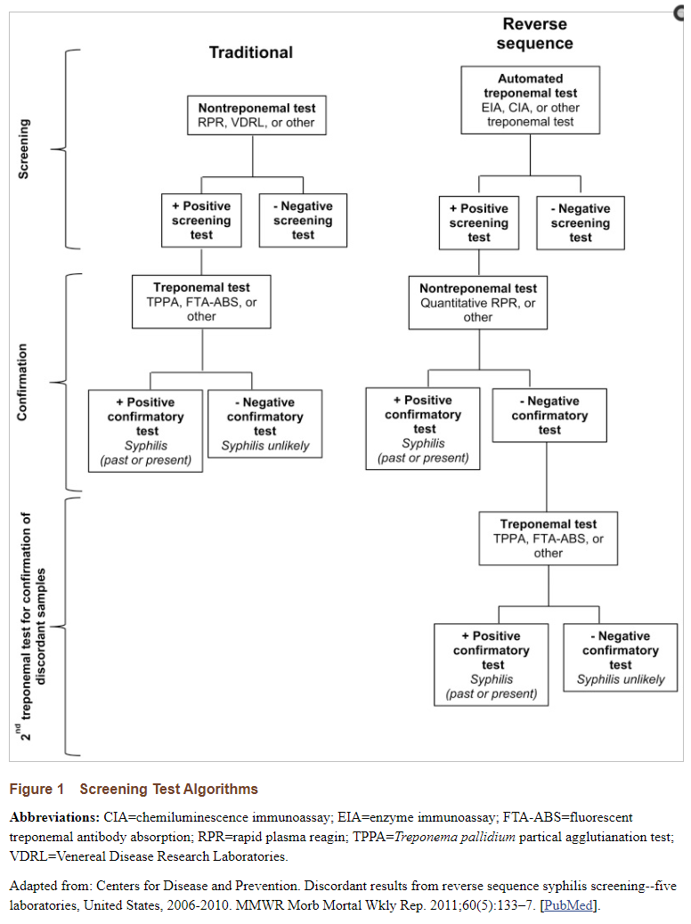
Approaches to Syphilis Testing: Traditional vs. Reverse Algorithm
The reverse screening algorithm for syphilis testing begins with a treponemal test and initially identifies all persons with syphilis – presently or previously infected; further testing steps, in combination with patient history and examination, can distinguish those presently infected from those with previous disease – whether treated, untreated, or incompletely treated syphilis.
Rapid syphilis treponemal tests are not recommended as a screening test in individuals with a known history of prior syphilis infection. Such individuals require non-treponemal tests to evaluate possible re-infection with syphilis.

Slide 10
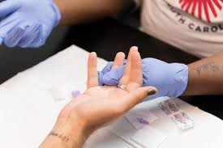
Use Cases From the National Coalition of STD Directors Pilot Program
FL DOH Alachua County and Miami Dade
Test prenatal women
Curb rising congenital syphilis rates
PrEP Implementation
Cudahy Health Department (3rd Coast Clinic-CHD)
Implementation into HIV Testing Event
Creating the “BIG 5” for STIs
Wyoming Department of Health
Use for homeless population
Streamline workflow
MO DOH collaborating with Columbia/Boone Public Health Dept
Reduce Turn Around Time

Slide 11
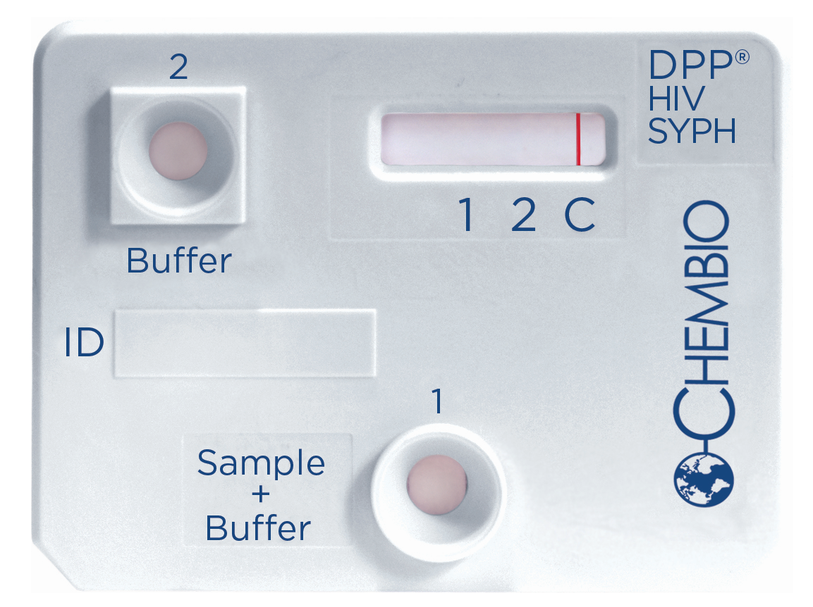
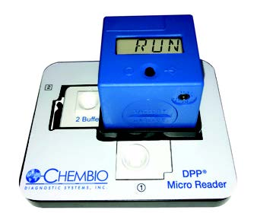
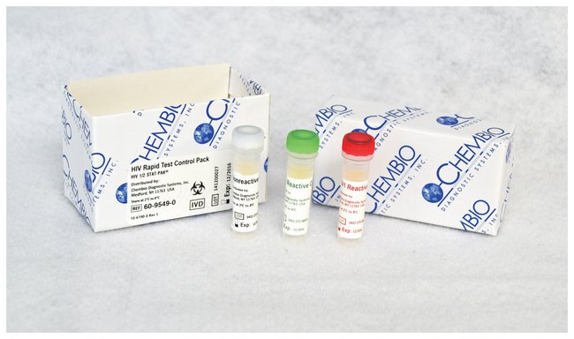
New Approach: DPP® HIV-Syphilis Rapid Test
FDA Approved in October 2020, Launched in 2021
Moderate Complexity; Pending CLIA Waiver
The first and only FDA Approved HIV-Syphilis rapid combo test in the USA
Part Number: 65-9502-0
Part Number: 70-1056-0
Part Number: 60-9555-0
Notes:
Number of tests sold INTL all time.

Slide 12
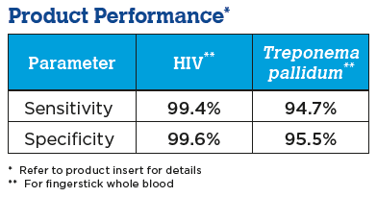
Overview of DPP HIV-Syphilis
A single-use rapid, qualitative, multiplex, immunoassay for the detection of antibodies to HIV-1/2, and/or Treponema pallidum bacteria (the causative agent of syphilis) in fingerstick whole blood, venous whole blood or plasma specimens.
Requires only 10 μL of either fingerstick whole blood, venous whole blood, or plasma
Provides results in 15 minutes and is read with the DPP Micro Reader

Slide 13
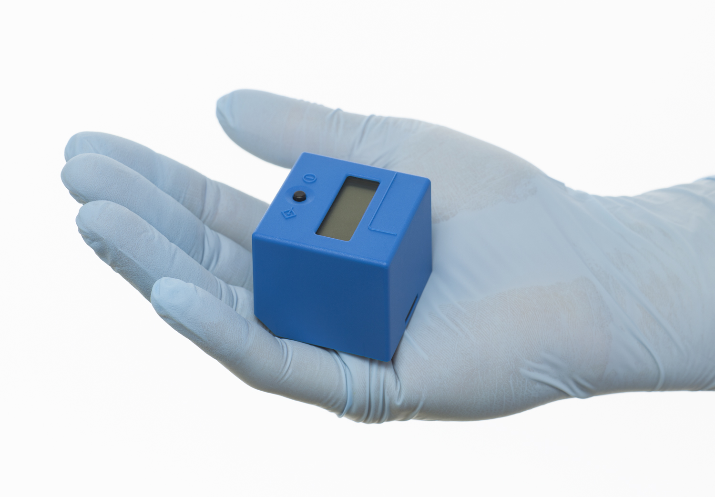
DPP® Micro Reader
Objective results reduce the possibility of the types of human error that can be experienced with visual interpretations
3000 reads per Micro Reader
Power source: 3 batteries CR2032 (3 V/230 mAh) or powered via USB cable

Slide 14
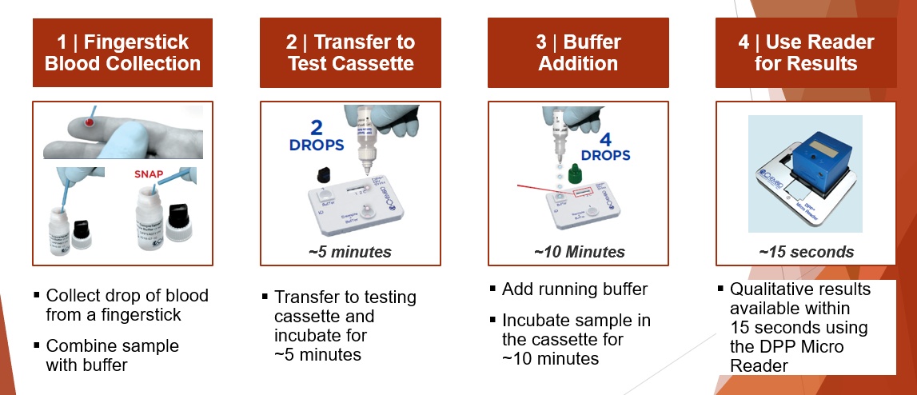
How to Run The Test
https://www.youtube.com/watch?v=c6en7ixDBhY&t=4s
Notes:
Mention: More info is available on reading the results and training video is available. FYI: Results will scroll on the screen.

Slide 15
Voices From The Field
1) CAPSLO The Center for Health & Prevention; San Luis Obispo, CA
Kayla Wilburn, Clinical Director
2) Diversity Family Health; Oklahoma City, OK
Russell Rooms MSN, APRN-CNP
3) KC CARE Health Centers; Kansas City, MO
Dr. Johny Gonzalez, MD, Program Coordinator for Testing and Counseling

Slide 16
DPP® HIV-Syphilis Pilot Program Presentation
By: Kayla Wilburn, Clinic Director
CAPSLO The Center for Health & Prevention
San Luis Obispo, CA

Slide 17
Objectives of Pilot
Assessment Of:
Workflow improvements with the “1 sample, 2 results” rapid combo DPP® HIV-Syphilis test
Improvements for our Patient Services Assistants (medical assistants + health educators)
Patient satisfaction improvements with the small fingerstick sample size and single combo test vs. running separate tests which is our current method
Decrease in patient opt-out of syphilis testing

Slide 18
Design of Study
Publicize the pilot study through avenues such as social media and patient focused posters
Draft messaging for the Patient Service Assistants to communicate the combo test as a “single test” and part of “routine screening”
Adjust workflow and patient education to fit combo test in place of current rapid HIV and separate syphilis tests
Begin testing 4/19 and run the pilot for 2 weeks
Collect outcome data and debrief with clinic staff

Slide 19
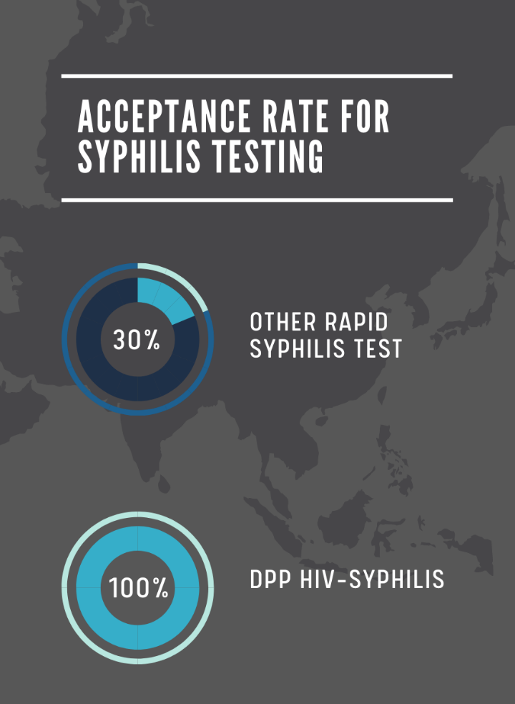
Conclusions/Findings
For the full month of March 2021, the clinic ran 108 HIV and 38 Syphilis tests.
Patient Population: 5 blocks from university, high school/ see a lot of teens, young adults. People with no insurance.
Patient Service Assistants presented a script on why to test for both HIV and Syphilis
We ran out of the 20 Chembio combo tests in 10 days.
100% acceptance rate with Chembio (compared to approx. 30% acceptance rate running Syphilis Health Check)

Slide 20
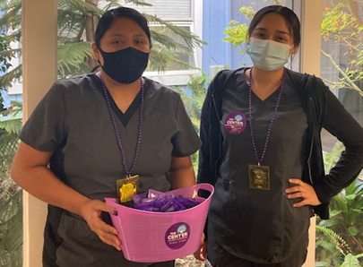
Conclusions/Findings
Out of the 20 tests run we had 1 HIV (+) and 1 syphilis (+)
Expedited treatment for syphilis on the spot
Patient sent to lab for RPR and got Confirmation of titers, but we gave treatment on site based on Clinician assessment.
In the past our testing staff had to do 2 fingersticks and Chembio’s test eliminates that. Patients come in nervous so its nice to have 1 test give them 2 results in minutes.
Staff loved running it. Specimen collection was easy. Loop was easy to use.

Slide 21
Conclusions/Findings
We are a member of the End the Epidemics Statewide Working Group focused on ending STI/HIV/Viral hepatitis in CA and see this test as a tool to help reach that goal.
Big 3: Chlamydia, Gonorrhea, and HIV is usually what people ask to be tested for. Now we can test the Big 4 including Syphilis with Chembio’s test and the opt-out script crafted by our Patient Services Assistants.
Happy to share the algorithm we use for testing and best practices!
HIV
Syphilis
Chlamydia
Gonorrhea

Slide 22
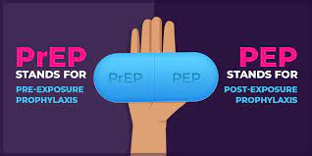
Future Plans
Team is working on a video for education on HIV and syphilis.
Promote on campuses to get tested with special testing days for students
Promote on social media and dating platforms (Tinder, Grinder and other dating sites)
Will begin offering PrEP/PEP services in the next few months.

Slide 23
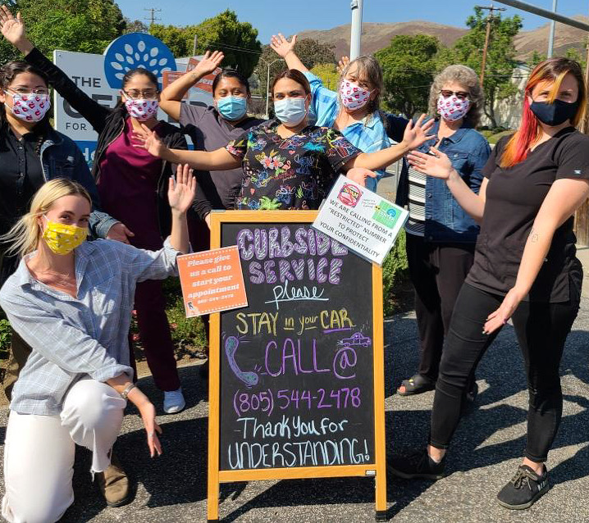
Kayla Wilburn, Clinic Director
CAPSLO The Center for Health & Prevention
kwilburn@capslo.org
805-544-2498 ext. 21

Slide 24
DPP® HIV-Syphilis Pilot Program Presentation
By:
Russell Rooms MSN, APRN-CNP
Diversity Family Health
Oklahoma City, OK

Slide 25
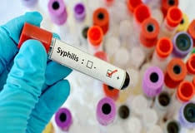
Current Testing
Using the Chembio SURE CHECK® HIV 1/2 test and sending out syphilis via venous blood draw. This takes approximately 48 hours to come back.
We see 16 patients per provider per day and occasionally we have 2 providers/day. We perform approx. 350 HIV tests per month.

Slide 26
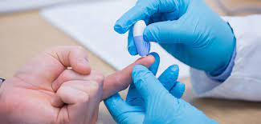
Objectives of Pilot
Assess ease of use of DPP® HIV-Syphilis for mass or festival testing
Determine the best process for rapid succession testing.

Slide 27
Design of Study
Event at local college offering free HIV and syphilis testing and PrEP.
There were 20 students scheduled with walk-in availability. Of those 20 scheduled, 16 came with no walk-ins.
Out of the 16 students, 3 had a history of syphilis and were excluded due to anticipated reactivity of the test.
13 students were tested using the DPP® HIV-Syphilis test.
The students had varying degrees of sexual activity in the recent and distant past.
All the students were non-reactive for both HIV and Syphilis (Treponemal).
4 of the 13 students were at future risk for HIV and chose to start or continue PrEP.
Those 4 had confirmatory laboratory testing for HIV and RPR that were also non-reactive.

Slide 28
Conclusions/Findings
The test was easy to use and straight forward.
When multiple students were in quick succession it was helpful to have pre-printed labels that had blanks for Patient Initials, Well 1 Time, Well 2 Time, Read Time, Results and a digital clock that would provide consistent time between clinicians.
Tests could then be read in quick succession with results given.
This helped to prevent a 15 minute per participant backlog.
At larger events I would recommend having one clinician working as lab tech and running the tests in a location outside of the clinical area.

Slide 29
DPP® HIV-Syphilis Pilot Program Presentation
By: Dr. Johny Gonzalez, MD
Program Coordinator for Testing and Counseling
KC CARE Health Centers
Kansas City, MO

Slide 30
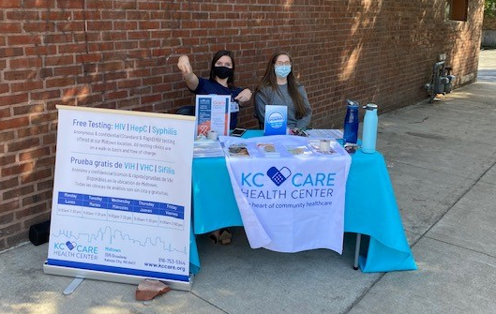
Objectives of Pilot
To increase and promote syphilis testing to our patients in the walk-in clinic by using the new Chembio DPP® HIV-Syphilis test. It is less invasive, provides fast results and reduces wait time for patients.

Slide 31
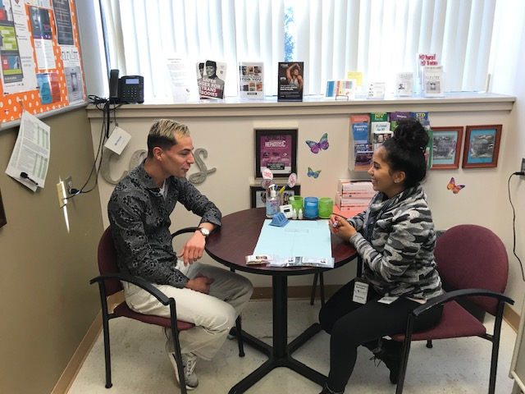
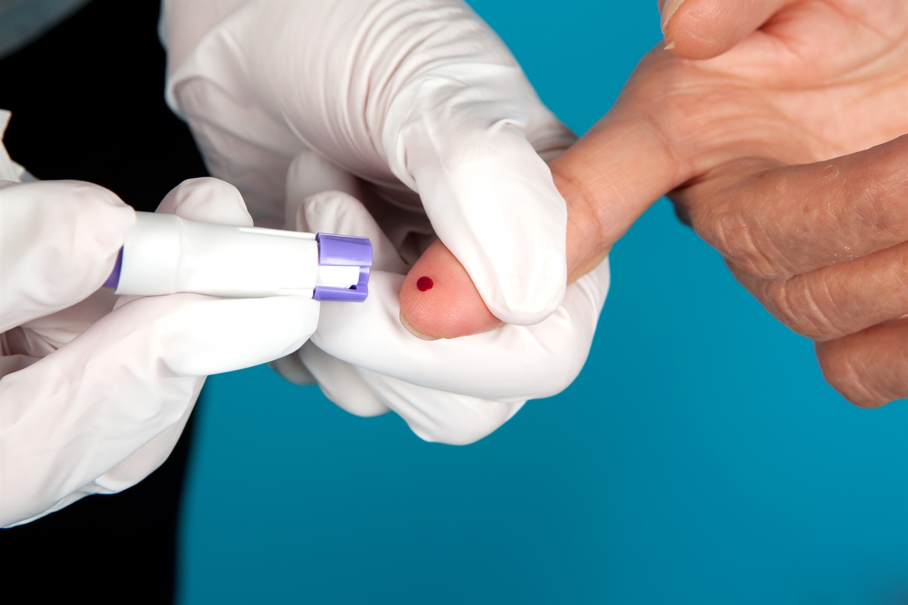
Design of Study
Offer Chembio’s DPP® HIV-Syphilis test to all patients that come to the free walk-in clinic with no history of syphilis.
Increase the number of patients testing for syphilis by
Reducing fears of venipuncture blood draw procedures
Reducing the long wait time to process their results

Slide 32
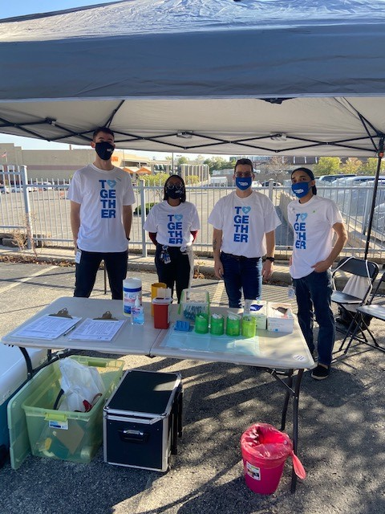
Conclusions/Findings
Patients felt more comfortable and willing to test for syphilis when we explained that the test only needed a fingerstick.
Tripled the number of patients who got tested for syphilis during this time than our regular monthly blood draw test.
Out of the 24 tests run we were able to detect 3 reactive results for HIV and 3 reactive results for syphilis, that were confirmed by regular protocols.
3x the normal number of patients tested for syphilis

Slide 33
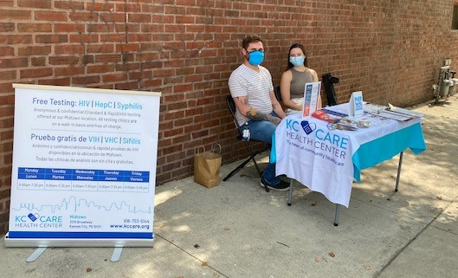
Conclusions/Findings
Easier process to assist patients in getting tested if vein scar is present, dehydrated, fearful to syringes or if they don’t have time to wait the long lines at the lab
Reduced waiting time by preventing the blood draw at the lab and waiting for the results.
Most patients felt comfortable with the DPP® HIV-Syphilis test for its minimally invasive procedure and how fast you get the results.
Other patients didn’t qualify for the test due to history of Syphilis or different test was used to cover window period for HIV exposure, Ex: Recent exposure that requires another type test that detect antigens

Slide 34
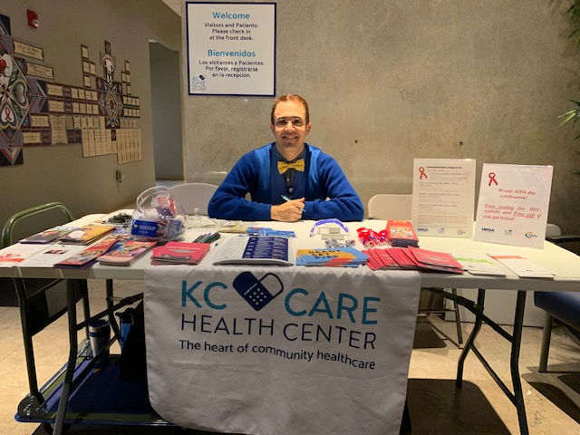
Conclusions/Findings
DPP® HIV-Syphilis is easy to use in the clinic and in outreach settings.
The DPP® Micro Reader makes reading the results easier and more accurate to avoid human mistakes.
Collection of finger stick blood is minimal and makes it easy on patients.

Slide 35
FIGHTING THE SYPHILIS AND HIV EPIDEMICS: VOICES FROM THE FIELD
Q & A

